Slide 1
Community Development Block Grant (CDBG) Transportation Fund
November 11, 2020

Slide 2
Training Agenda
What is CDBG Funds?
How do your clients qualify?
Verifiable Appointments
Referral Process
Forms
Pick-up location for tokens and smartrip cards
Launch Date and Additional Training dates
Q & A

Slide 3
What is CDBG Transportation Fund ?
The Prince William County’s Department of Social Services (DSS) has transportation funds available for the homeless in the Prince William Area (PWA) including Manassas Park and City of Manassas. DSS was awarded $40,000.00 per fiscal year for the next five years until June 30, 2025 for a total of $200,000.00 to provide transportation services. less individuals.

Slide 4
How Do Your Clients Qualify?
2021 HUD Income Limits for the DC-VA-MD HUD Metro FMR Area 4-01-2020 according to the household size.
 | 1 person | 2 persons | 3 person | 4 person | 5 person | 6 person | 7 person | 8 person
Extremely Low (0-30%) | $26,500 | $30,250 | $34,050 | $37,800 | $40,850 | $43,850 | $46,900 | $49,900
Low (31-50%) | $44,100 | $50,400 | $56,700 | $63,000 | $68,050 | $73,100 | $78,150 | $83,200
Moderate (51-80%) | $55,750 | $63,700 | $71,650 | $79,600 | $86,000 | $92,350 | $98,750 | $105,100

Slide 5
What can CDBG Transportation Funds be used for the following verifiable appointments?
Facility | Type of appointment
Medical clinics: | Mental health, private physician, dental, medical appointments.
Detoxification facilities: | Detox programs, methadone clinic, substance abuse/use programs.
Public assistance offices: | TANF, Medicaid, Medicare, Food Stamps/EBT, mainstream benefits.
Other local providers: | Probation/parole, CSB, court appointments, Employment (SkillSource Center), attorney, and training programs.
Any other transportation needs: | Hypothermia, job interviews, job searches, housing searches, and transportation to emergency shelter.

Slide 6
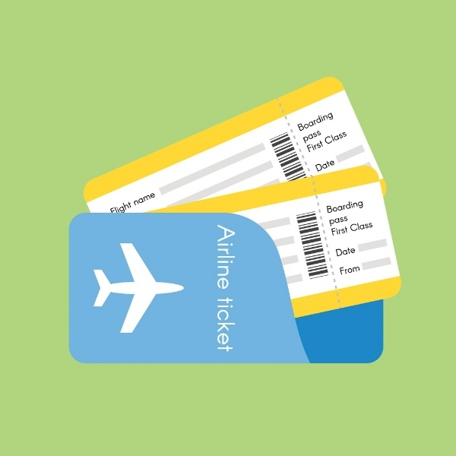
Transportation funds could also include:
Smartrip farecards, bus tokens, and in some cases, we can purchase one-way tickets for clients traveling by bus or train for a verifiable permanent housing situation.

Slide 7
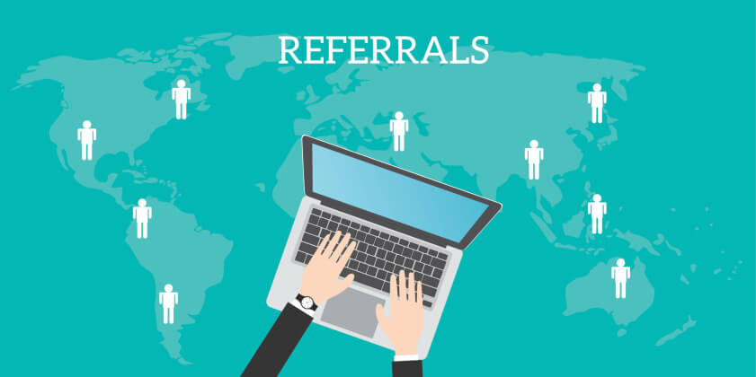
Referral Process
Referrals and inquiries related the CDBG funds will be processed through the CES (Coordinated Entry System) via email to DSScdbgtrans@pwcgov.org only.
All requests submitted by noon Monday – Friday will be processed the same business day. Request submitted after noon will be processed the next business day.
All request should be submitted at least 48 hours Monday – Friday prior to need of the transportation request.
You will receive a response within those 24 hours Monday – Friday if your request has been accepted or denied via email.

Slide 8
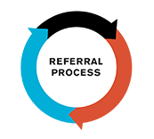
Referral Process (con’t)
Each referring agency will be responsible for completing the CDGB Transportation Fund Referral Sheet and a statement on your company’s letterhead verifying the client meets the required criteria (income level and type of appointment) for CDBG transportation funds.

Slide 9
Forms: CDBG Transportation Fund Referral Sheet, page 1

Slide 10
Forms: CDBG Transportation Fund Referral Sheet, page 2

Slide 11
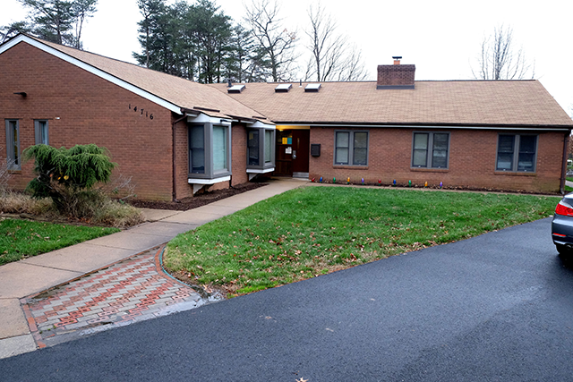
Pick-up locations for farecards and tokens
Farecards and tokens are available for pick-up at the Bill Mehr Drop-In Center located at 14716 Potomac Mills Road, Woodbridge, VA 22192.
Monday – Thursday from
8:30 a.m. – 3:00 p.m.

Slide 12
Launch date/Additional Trainings
Launch date to start receiving referrals:
Monday, November 16, 2020
Additional Training Opportunities:
Friday, November 20, 2020 1:00 p.m. – 2:00 p.m. via webex.
Thursday, December 3, 2020 9:30 a.m. – 12:00 p.m. during our regular scheduled Service Continuum Meeting via webex.

Slide 13
Questions
Please email DSSCDBGtrans@pwcgov.org

